Slide 1


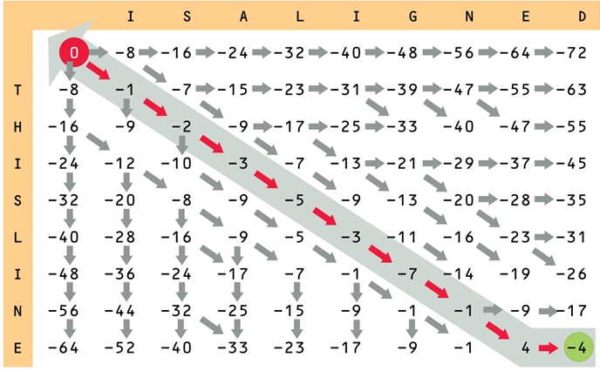

Dynamic Programming
Divide-and-Conquer, Dynamic Programming, and Memoization
Dynamic Programming
SoftUni Team
Technical Trainers
Software University
http://softuni.bg

Slide 2

Table of Contents
Divide-and-Conquer
Dynamic Programming Concepts
Fibonacci Numbers and Memoization
Longest Increasing Subsequence (LIS)
"Move Down / Right" Problem
The "Subset Sum" Problem
Longest Common Subsequence (LCS)
The "Knapsack" Problem

Slide 3
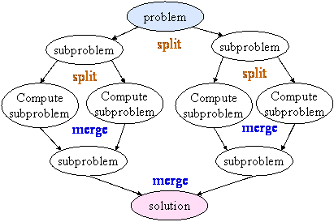
Divide-and-Conquer

Slide 4
Divide-and-Conquer
Divide-and-conquer programming technique divides the problem into disjoint sub-problems, solves them and combines the results
Examples: MergeSort, QuickSort, Map-Reduce algorithms
Steps in divide-and-conquer
Divide: divide the problem into two or more disjoint sub-problems
Sub-problems are disjoint (not intersecting)
Conquer: conquer recursively to solve the subproblems
Combine: take the solutions to the subproblems and "merge" these solutions into a solution for the original problem

Slide 5
Divide-and-Conquer Example
MergeSort
The sub-problems are independent, all different
void MergeSort(int[] arr, int left, int right)
{
if (right > left)
{
int mid = (right + left) / 2;
MergeSort(arr, left, mid);
MergeSort(arr, (mid+1), right);
Merge(arr, left, (mid+1), right);
}
}

Slide 6


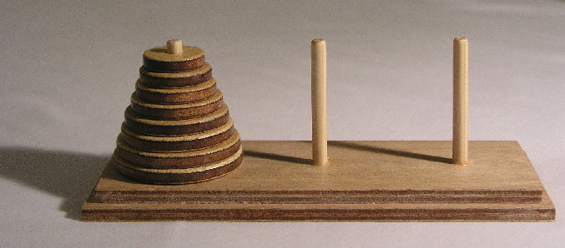
Divide-and-Conquer Algorithms
Binary search
Closest pair in 2D geometry
QuickSort
Merging sorted arrays
MergeSort
Finding majorant
Tower of Hanoi
Fast matrix multiplication

Slide 7
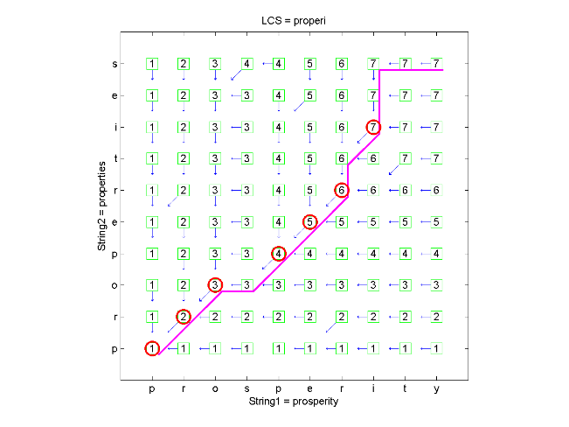
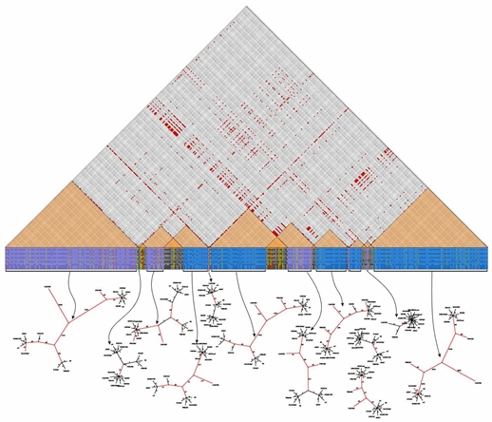
Dynamic Programming
Concepts

Slide 8
Dynamic Programming
How dynamic programming (DP) works?
Solve problems by breaking them into smaller problems
Store partial solutions of the smaller problems
Combine smaller problem to solve the bigger problem
Steps to design a DP algorithm:
Find an optimal substructure (problem solved by sub-problems)
Recursively define the value of an optimal solution
Compute the value bottom-up or top-down
Construct an optimal solution (if needed)

Slide 9
Characteristics of DP
Simple sub-problems
Break the original problem to smaller sub-problems
That have the same structure
Optimal substructure of the problems
The optimal solution to the problem contains within optimal solutions to its sub-problems
Overlapping sub-problems
Solution to the same sub-problem could be needed multiple times

Slide 10
Dynamic Programming vs. Divide-and-Conquer
Use divide-and-conquer for non-overlapping sub-problems
Any sub-problem should be solved once only
Example: recursive factorial
Use dynamic programming (DP) for overlapping sub-problems
Solve each sub-problem once store its answer in a table
Thus avoid solving the same sub-problems multiple times
Technique known as "memoization"
Example: recursive Fibonacci numbers

Slide 11
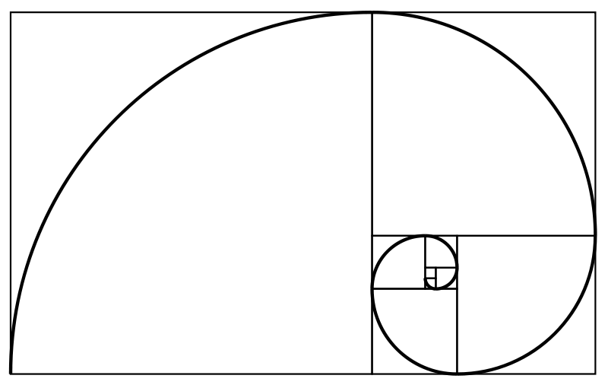
Example: Fibonacci Sequence
The Fibonacci sequence holds the following integers:
0, 1, 1, 2, 3, 5, 8, 13, 21, 34, 55, 89, 144, …
The first two numbers are 0 and 1
Each subsequent number is the sum of the previous two numbers
Recursive mathematical formula:
F₀ = 0, F₁ = 1
F_{n} = F_{n-1} + F_{n-2}

Slide 12
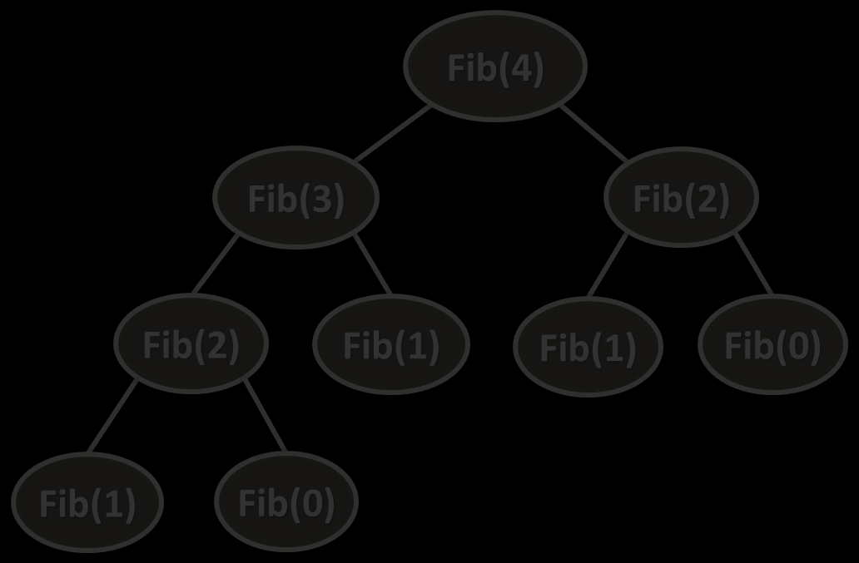
Dynamic Programming: Top-Down
Top-down approach in dynamic programming
Typically implemented recursively
Example: Fibonacci
Fib(4) → Fib(3), Fib(2)
Fib(3) → Fib(2), Fib(1)
Fib(2) → Fib(1), Fib(0)
Fib(1), Fib(0)
Fib(4)
Fib(3)
Fib(2)
Fib(2)
Fib(1)
Fib(1)
Fib(0)
Fib(1)
Fib(0)

Slide 13
Dynamic Programming: Bottom-Up
Bottom-up approach in dynamic programming
Typically implemented iteratively
Example: Fibonacci
Fib(0)
Fib(1)
Fib(0), Fib(1) → Fib(2)
Fib(1), Fib(2) → Fib(3)
Fib(2), Fib(3) → Fib(4)
Fib(4)
Fib(3)
Fib(2)
0
1
2
3
4
0
1
1
2
4
Fib(2)
Fib(1)
Fib(1)
Fib(0)
Fib(1)
Fib(0)

Slide 14

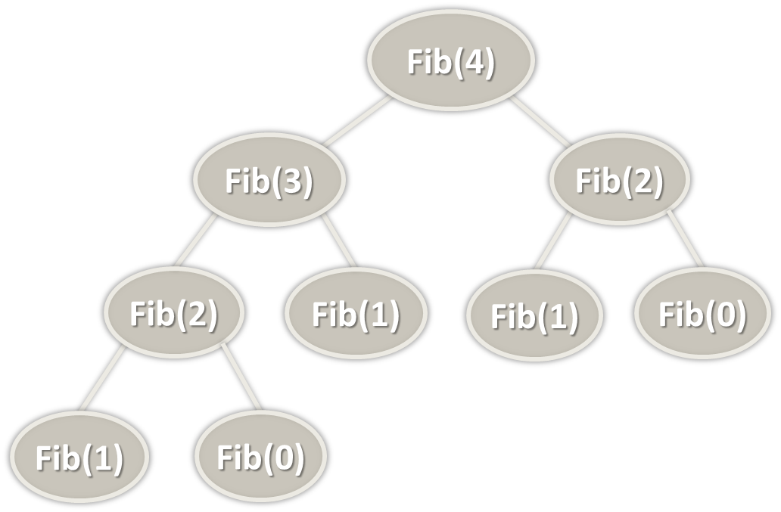
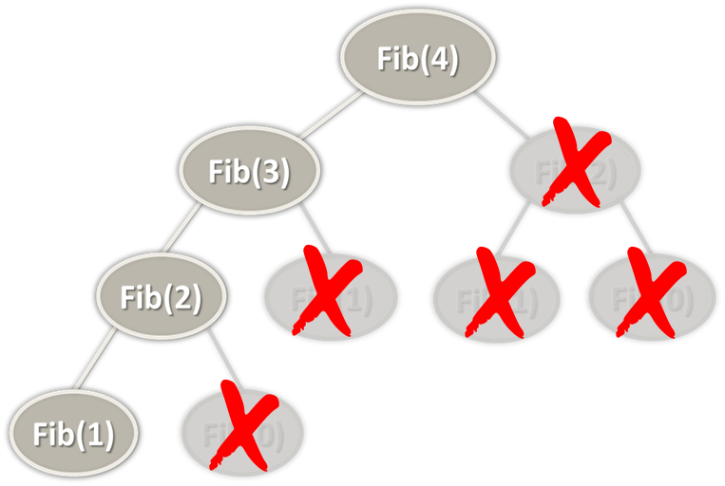
Fibonacci Calculation
From "Divide-and-Conquer" to Dynamic Programming and Memoization

Slide 15
Fibonacci and Divide-and-Conquer
Find the n^{th} Fibonacci number using recursion directly
Divide-and-conquer calculation → very slow!
decimal Fibonacci(int n)
{
if (n == 0)
return 0;
if (n == 1)
return 1;
return
Fibonacci(n - 1) +
Fibonacci(n - 2);
}

Slide 16
Fibonacci and DP: Top-Down (Memoization)
Save each calculated value in a table for further use
This saves a lot of useless recursive calculations!
Also known as top-down calculation with memoization
decimal Fibonacci(int n)
{ if (memo[n] != 0) return memo[n];
if (n == 0) return 0;
if (n == 1) return 1;
memo[n] = Fibonacci(n - 1) +
Fibonacci(n - 2);
return memo[n];
}

Slide 17
Fibonacci and DP: Bottom-Up
Calculating Fibonacci in bottom-up order, iteratively:
decimal Fibonacci(int n)
{
decimal[] fib = new decimal[n+2];
fib[0] = 0;
fib[1] = 1;
for (int i=2; i<=n; i++)
fib[i] = fib[i-1] + fib[i-2];
return fib[n];
}
0 | 1
0 | 1
2
1
3
2
4
3
5
5
6
8
…
…
i^{th}
F_{i-1} + F_{i-2}
…
…
n^{th}
…

Slide 18
Compare Fibonacci Solutions
Recursive Fibonacci (divide-and-conquer, no memoization)
Complexity: ~ O(1.6^{n})
Top-down dynamic programming (recursive with memorization)
Complexity: ~ O(n)
Bottom-up dynamic programming (iterative)
Complexity: ~ O(n)
If we want to find the 36th Fibonacci number:
Recursive solution takes ~ 48 315 633 steps
Dynamic programming solution takes ~ 36 steps

Slide 19
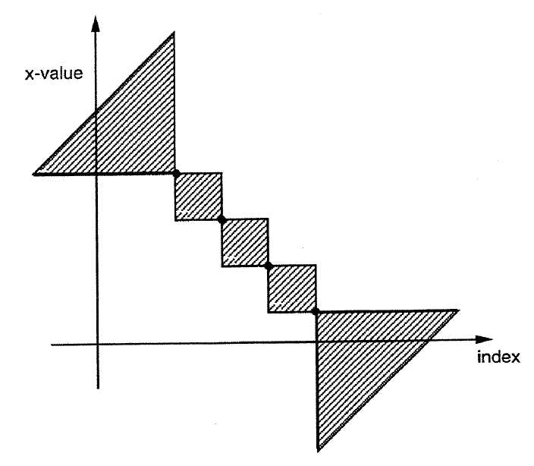
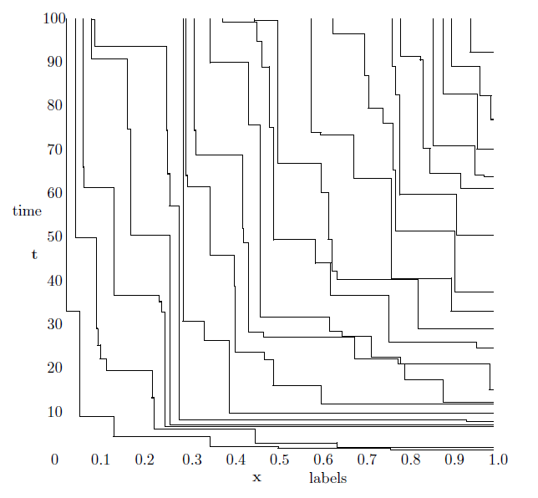
Longest Increasing Subsequence (LIS)

Slide 20
Longest Increasing Subsequence (LIS)
LIS (longest increasing subsequence) problem
Goal: find the largest subsequence of increasing numbers within a given sequence
This subsequence is not necessarily contiguous, or unique
Example:
{7, 3, 5, 8, -1, 6, 7} → {3, 5, 6, 7}
The LIS problem is solvable in O(n * log n) time
Let's review a simple DP algorithm with complexity of O(n²)

Slide 21
LIS – Solution with Dynamic Programming
Let's seq[] = {3, 14, 5, 12, 15, 7, 8, 9, 11, 10, 1}
Let's len[x] = length of the LIS ending at the element seq[x]
We have optimal substructure and a recursive formula:
len[x] = 1 + max(len[i]) for i ϵ [0 … x-1], where seq[i] < seq[x]
index | 0 | 1 | 2 | 3 | 4 | 5 | 6 | 7 | 8 | 9 | 10
seq[] | 3 | 14 | 5 | 12 | 15 | 7 | 8 | 9 | 11 | 10 | 1
len[] | 1 | 2 | 2 | 3 | 4 | 3 | 4 | 5 | 6 | 6 | 1
LIS | {3} | {3,14} | {3,5} | {3,5,12} | {3,5,12,15} | {3,5,7} | {3,5,7,8} | {3,5,7,8,9} | {3,5,7,8,9,11} | {3,5,7,8,9,10} | {1}

Slide 22
LIS: Bottom-Up Calculation
Bottom-up calculation the LIS length:
len[0] = 1
len[0] → len[1]
len[0…1] → len[2]
len[0…2] → len[3]
…
len[0…n-1] → len[n]
1
1 | x
1 | … | x
1 | … | … | x
i = 1 … x-1
1 | … | … | … | … | … | … | x
len[x] = 1 + max(len[i])

Slide 23
Calculating LIS – Source Code
int[] seq = { 3, 4, 8, 1, 2, 4, 32, 6, 2, 5, 33, 4, 38, 22 };
int[] len = new int[seq.Length];
for (int x = 0; x < seq.Length; x++)
{
len[x] = 1;
for (int i = 0; i <= x - 1; i++)
if (seq[i] < seq[x] && len[i] + 1 > len[x])
len[x] = 1 + len[i];
}
index | 0 | 1 | 2 | 3 | 4 | 5 | 6 | 7 | 8 | 9 | 10
seq[] | 3 | 14 | 5 | 12 | 15 | 7 | 8 | 9 | 11 | 10 | 1
len[] | 1 | 2 | 2 | 3 | 4 | 3 | 4 | 5 | 6 | 6 | 1

Slide 24
LIS – Restoring the Sequence
How to restore the LIS from the calculated len[] values?
We can keep prev[x] to hold the predecessor of seq[x]
index | 0 | 1 | 2 | 3 | 4 | 5 | 6 | 7 | 8 | 9 | 10
seq[] | 3 | 14 | 5 | 12 | 15 | 7 | 8 | 9 | 11 | 10 | 1
len[] | 1 | 2 | 2 | 3 | 4 | 3 | 4 | 5 | 6 | 6 | 1
prev[] | -1 | 0 | 0 | 2 | 3 | 2 | 5 | 6 | 7 | 7 | -1
LIS | {3} | {3,14} | {3,5} | {3,5,12} | {3,5,12,15} | {3,5,7} | {3,5,7,8} | {3,5,7,8,9} | {3,5,7,8,9,11} | {3,5,7,8,9,10} | {1}

Slide 25
Calculating LIS with Previous – Source Code
int maxLen = 0;
int lastIndex = -1;
for (int x = 0; x < seq.Length; x++)
{
len[x] = 1;
prev[x] = -1;
for (int i = 0; i < x; i++)
if ((seq[i] < seq[x]) && (len[i] + 1 > len[x]))
{
len[x] = len[i] + 1;
prev[x] = i;
}
if (len[x] > maxLen)
{
maxLen = len[x];
lastIndex = x;
}
}

Slide 26
Restoring LIS Elements – Source Code
int[] RestoreLIS(int[] seq, int[] prev, int lastIndex)
{
var longestSeq = new List<int>();
while (lastIndex != -1)
{
longestSeq.Add(sequence[lastIndex]);
lastIndex = prev[lastIndex];
}
longestSeq.Reverse();
return longestSeq.ToArray();
}

Slide 27
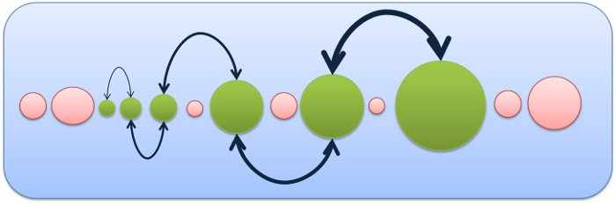
Longest Increasing Subsequence (LIS)
Live Coding (Lab)

Slide 28

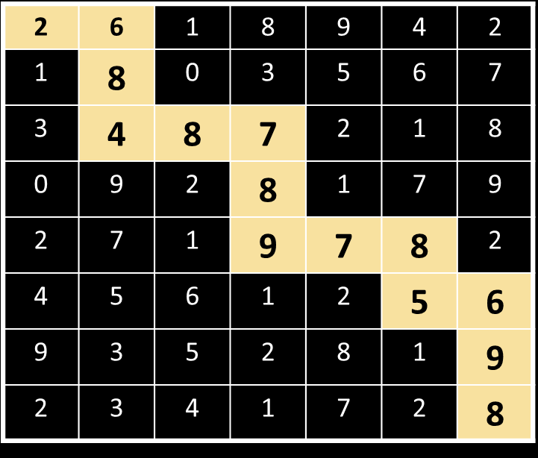
"Move Down / Right Sum" Problem

Slide 29
"Move Down / Right Sum" Problem
You are given a matrix of numbers
Find the largest sum of cells
Starting from the top left corner
Ending at the bottom right corner
Going down or right at each step
Dynamic programming solution:
sum[row, col] = cell[row, col] + max(sum[row-1, col], sum[row, col-1])
2 | 6 | 1 | 8 | 9 | 4 | 2
1 | 8 | 0 | 3 | 5 | 6 | 7
3 | 4 | 8 | 7 | 2 | 1 | 8
0 | 9 | 2 | 8 | 1 | 7 | 9
2 | 7 | 1 | 9 | 7 | 8 | 2
4 | 5 | 6 | 1 | 2 | 5 | 6
9 | 3 | 5 | 2 | 8 | 1 | 9
2 | 3 | 4 | 1 | 7 | 2 | 8

Slide 30
Move Down / Right: Calculation Process
sum[rows, cols]
sum[rows + 1, cols + 1]
… | … | … | … | … | …
… | … | … | … | … | …
… | … | … | … | … | …
… | … | … | … | … | …
… | … | … | … | … | …
… | … | … | … | … | …
… | … | … | … | … | …
… | … | … | … | … | …
… | … | … | … | … | …
… | … | … | … | … | …
… | … | … | … | … | …
… | … | … | … | … | …
… | … | … | … | … | …
… | … | … | … | … | …
 |  |  |  |  |  | …
 |  |  |  |  |  | …
 |  |  |  |  |  | …
 |  |  |  |  |  | …
 |  |  |  |  |  | …
 |  |  |  |  |  | …
 |  |  |  |  |  | …
… | … | … | … | … | … | …

Slide 31
"Move Down / Right Sum" – Solution
for (int row = 0; row < rowsCount; row++)
for (int col = 0; col < colsCount; col++)
{
long maxPrevCell = long.MinValue;
if (col > 0 && sum[row, col - 1] > maxPrevCell)
maxPrevCell = sum[row, col - 1];
if (row > 0 && sum[row - 1, col] > maxPrevCell)
maxPrevCell = sum[row - 1, col];
sum[row, col] = cells[row, col];
if (maxPrevCell != long.MinValue)
sum[row, col] += maxPrevCell;
}

Slide 32
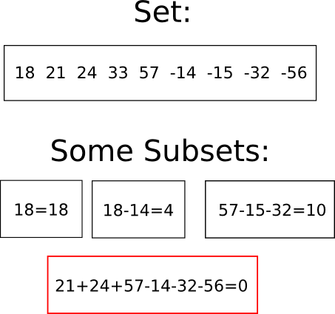
The "Subset Sum" Problem

Slide 33
Subset Sum Problem and Its Variations
Subset sum problem (zero subset sum problem)
Given a set of integers, find a non-empty subset whose sum 0
E.g. {8, 3, -50, 1, -2, -1, 15, -2} → {3, 1, -2, -2}
Given a set of integers and an integer S, find a subset whose sum is S
E.g. {8, 3, 2, 1, 12, 1}, S=16 → {3, 1, 12}
Given a set of integers, find all possible sums
Can you split given sum into set of coins?

Slide 34
Subset Sum Problem (No Repeats)
Solving the subset sum problem:
nums = { 3, 5, 1, 4, 2 }, targetSum = 6
Start with possibleSums = { 0 }
Step 1: obtain all possible sums ending at { 3 }
possibleSums = { 0 } ∪ { 0+3 } = { 0, 3 }
Step 2: obtain all possible sums ending at { 5 }
possibleSums = { 0, 3 } ∪ { 0+5, 3+5 } = { 0, 3, 5, 8 }
Step 3: obtain all possible sums ending at { 1 }
possibleSums = { 0, 3, 5, 8 } ∪ { 0+1, 3+1, 5+1, 8+1 } = {0, 1, 3, 4, 5, 6, 8, 9}
3 | 5 | 1 | 4 | 2
{ 0 }
3 | 5 | 1 | 4 | 2
{ 0, 3 }
3 | 5 | 1 | 4 | 2
{ 0, 3, 5, 8 }
3 | 5 | 1 | 4 | 2
{0, 1, 3, 4, 5, 6, 8, 9}

Slide 35
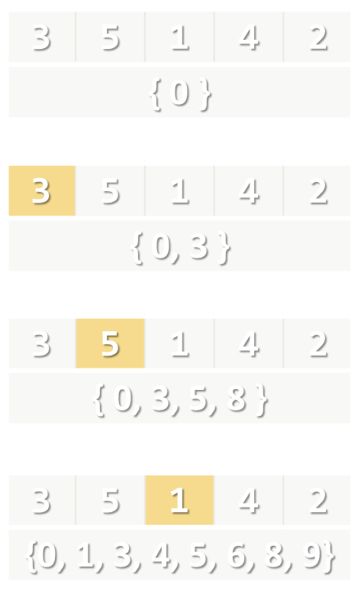
Subset Sum Problem (No Repeats)
static ISet<int> CalcPossibleSumsSet(int[] nums, int targetSum)
{
var possibleSums = new HashSet<int>() { 0 };
for (int i = 0; i < nums.Length; i++)
{
var newSums = new HashSet<int>();
foreach (var sum in possibleSums)
{
int newSum = sum + nums[i];
newSums.Add(newSum);
}
possibleSums.UnionWith(newSums);
}
return possibleSums;
}

Slide 36
Subset Sum: How to Recover the Subset?
Keep for each obtained sum in possibleSums, how it is obtained
Use a dictionary instead of set:
possibleSums[s] → num
The sum s is obtained by adding num to some previously obtained subset sum
3 | 5 | 1 | 4 | 2
{ 0 → 0 }
3 | 5 | 1 | 4 | 2
{ 0 → 0 }, { 3 → 3 }
3 | 5 | 1 | 4 | 2
{ 0 → 0 }, { 3 → 3 }, { 5 → 5 }, { 8 → 5 }
3 | 5 | 1 | 4 | 2
{0 → 0 }, { 1 → 1 }, { 3 → 3 }, { 4 → 1 }, { 5 → 5 }, { 6 → 1 }, { 8 → 5 }, { 9 → 1}

Slide 37
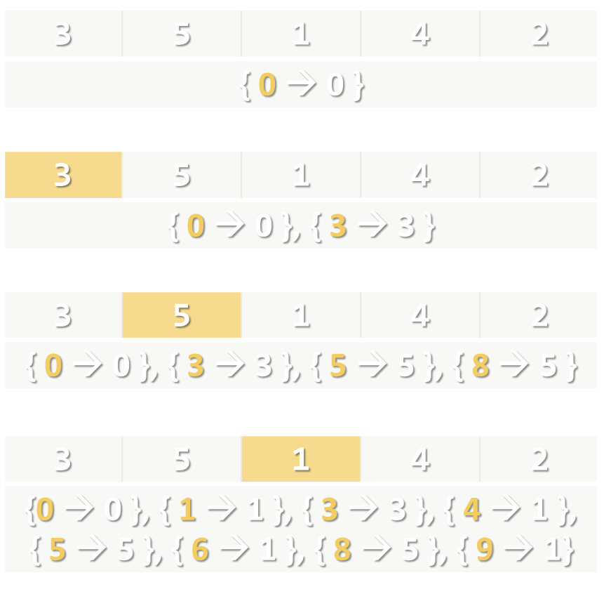
Subset Sum (No Repeats + Subset Recovery)
static IDictionary<int, int> CalcPossibleSums(
int[] nums, int targetSum) {
var possibleSums = new Dictionary<int, int>();
possibleSums.Add(0, 0);
for (int i = 0; i < nums.Length; i++) {
var newSums = new Dictionary<int, int>();
foreach (var sum in possibleSums.Keys) {
int newSum = sum + nums[i];
if (!possibleSums.ContainsKey(newSum))
newSums.Add(newSum, nums[i]);
}
foreach (var sum in newSums)
possibleSums.Add(sum.Key, sum.Value);
}
return possibleSums;
}

Slide 38
Subset Sum (No Repeats): Subset Recovery
static List<int> FindSubset(int[] nums, int targetSum,
IDictionary<int, int> possibleSums)
{
var subset = new List<int>();
while (targetSum > 0)
{
var lastNum = possibleSums[targetSum];
subset.Add(lastNum);
targetSum -= lastNum;
}
subset.Reverse();
return subset;
}
{ 9 → 1} → { 8 → 5 } → { 5 → 5 } → 0

Slide 39
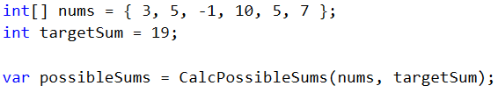

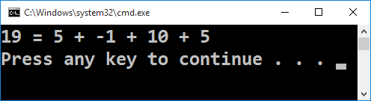
Subset Sum (with No Repeats)
Live Demo

Slide 40
Subset Sum Problem (With Repeats)
Solving the subset sum problem (BFS-based algorithm):
nums = { 3, 5, 2 }, targetSum = 6
{ 0 }
{ 0, 0+3, 0+5, 0+2 }
{ 0, 2, 3, 5 }
possibleSums = { 0 };
for i = 0 … targetSum
{
Append to possibleSums[i] all numbers from nums[]
}
{ 0, 2, 3, 5} ∪ { 2+3, 2+5, 2+2 }
{ 0, 2, 3, 4, 5, 7 }
{ 0, 2, 3, 4, 5, 7 } ∪ { 3+3, 3+5, 3+2 }
{ 0, 2, 3, 4, 5, 6, 7, 8 }
…

Slide 41
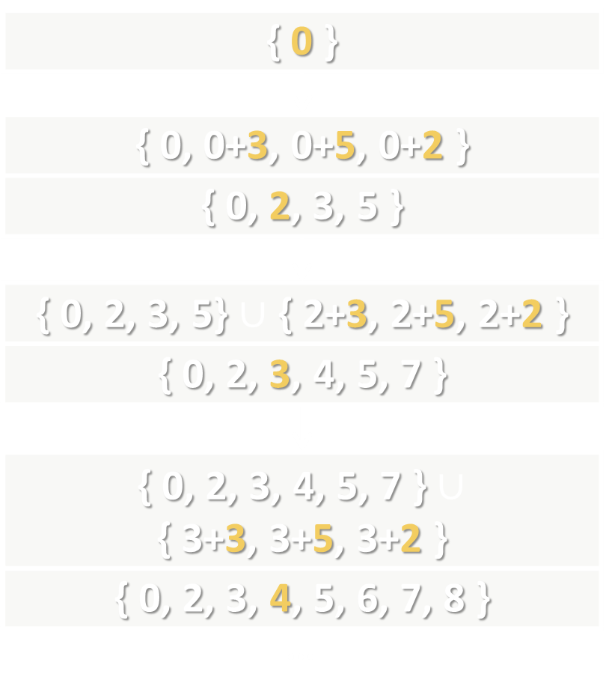
Subset Sum (With Repeats)
static bool[] CalcPossibleSums(int[] nums, int targetSum)
{
var possible = new bool[targetSum + 1];
possible[0] = true;
for (int sum = 0; sum < possible.Length; sum++)
if (possible[sum])
for (int i = 0; i < nums.Length; i++)
{
int newSum = sum + nums[i];
if (newSum <= targetSum)
possible[newSum] = true;
}
return possible;
}

Slide 42
Subset Sum (With Repeats): Recovery
private static IEnumerable<int> FindSubset(
int[] nums, int targetSum, bool[] possibleSums)
{
var subset = new List<int>();
while (targetSum > 0)
for (int i = 0; i < nums.Length; i++)
{
int newSum = targetSum - nums[i];
if (newSum >= 0 && possibleSums[newSum])
{
targetSum = newSum;
subset.Add(nums[i]);
}
}
return subset;
}

Slide 43
Subset Sum (With Repeats)
Live Demo

Slide 44
Subset Sums (No Repeat, Recursive)
Another solution to the "subset sums" problem
Let possibleSum[i, s] is true if the sum s can be obtained by summing a subset of nums[0 … i]
The following formulas are valid:
possibleSum[i, s] == false when i < 0 or s < 0
possibleSum[i, s] == true when nums[i] == sum or possibleSum[i-1, s] or possibleSum[i-1, s – nums[i]]

Slide 45
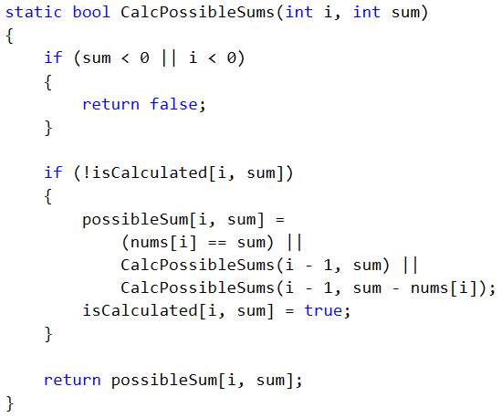
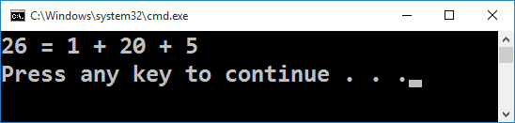
Subset Sum (With Matrix)
Live Demo

Slide 46
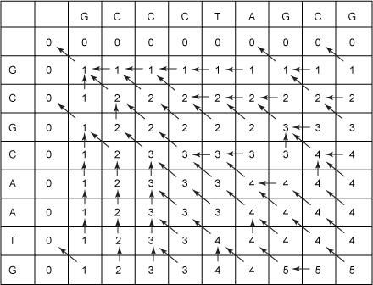
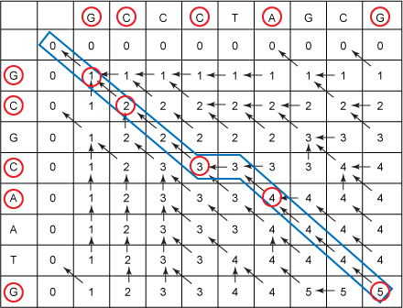
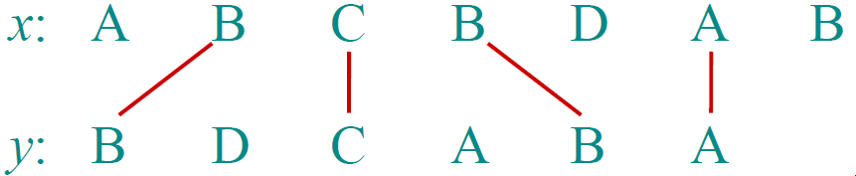
Longest Common Subsequence (LCS)
A Recursive DP Approach

Slide 47
Longest Common Subsequence (LCS)
Longest common subsequence (LCS) problem:
Given two sequences x[1 … m] and y[1 … n]
Find a longest common subsequence (LCS) to them both
Example:
x = "ABCBDAB"
y = "BDCABA"
LCS = "BCBA"

Slide 48
LCS – Recursive Approach
S₁ = GCCCTAGCG, S₂ = GCGCAATG
Let C₁ = the right-most character of S₁ (C₁ = G)
Let C₂ = the right-most character of S₂ (C₂ = G)
Let S₁' = S₁ with C₁ "chopped-off" (S₁' = GCCCTAGC)
Let S₂' = S₂ with C₂ "chopped-off" (S₂' = GCGCAAT)
There are three recursive sub-problems:
L₁ = LCS(S₁', S₂)
L₂ = LCS(S₁, S₂')
L₃ = LCS(S₁', S₂')

Slide 49
LCS – Recursive Formula
Let lcs[x, y] is the longest common subsequence of S₁[0 … x] and S₂[0 … y]
LCS has the following recursive properties:
lcs[-1, y] = 0
lcs[x, -1] = 0
lcs[x, y] = max(
lcs[x-1, y],
lcs[x, y-1],
lcs[x-1, y-1] when S₁[x] == S₂[y]
)

Slide 50
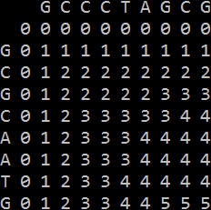
Calculating the LCS Table
static int CalcLCS(int x, int y) {
if (x < 0 || y < 0)
return 0;
if (lcs[x, y] == NOT_CALCULATED) {
int lcsFirstMinusOne = CalcLCS(x - 1, y);
int lcsSecondMinusOne = CalcLCS(x, y - 1);
lcs[x, y] = Math.Max(
lcsFirstMinusOne, lcsSecondMinusOne);
if (firstStr[x] == secondStr[y]) {
int lcsBothMinusOne = 1 + CalcLCS(x - 1, y - 1);
lcs[x, y] = Math.Max(lcs[x, y], lcsBothMinusOne);
}
}
return lcs[x, y];
}

Slide 51
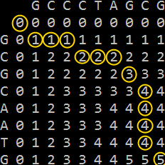
Reconstructing the LCS Sequence
static string PrintLCS(int x, int y) {
var lcsLetters = new List<char>();
while (x >= 0 && y >= 0)
if ((firstStr[x] == secondStr[y]) &&
(CalcLCS(x - 1, y - 1) + 1 == lcs[x, y])) {
lcsLetters.Add(firstStr[x]);
x--;
y--;
}
else if (CalcLCS(x - 1, y) == lcs[x, y])
x--;
else
y--;
lcsLetters.Reverse();
return string.Join("", lcsLetters);
}

Slide 52
Longest Common Subsequence (LCS)
Live Coding (Lab)

Slide 53
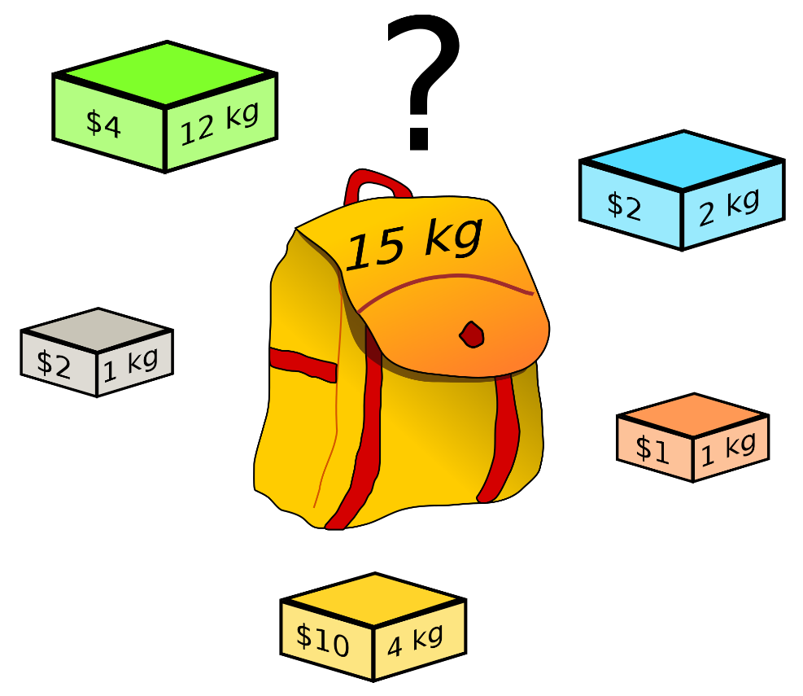
The "Knapsack" Problem

Slide 54

The "Knapsack" Problem
We have n items
Each item has price c_{i} and weight w_{i}
We have a knapsack of given capacity (maximum weight)
We want to take maximal priced items within the knapsack capacity
Take a subset of the items, so that:
The total price is maximal
The total weigth ≤ capacity

Slide 55

The "Knapsack" Problem – Example
Available items:
# | Weight | Price
0 | 5 | 30
1 | 8 | 120
2 | 7 | 10
3 | 0 | 20
4 | 4 | 50
5 | 5 | 80
6 | 2 | 10
Items taken:
# | Weight | Price
1 | 8 | 120
3 | 0 | 20
5 | 5 | 80
6 | 2 | 10
15 kg

Slide 56

The "Knapsack" Problem
Live Coding (Lab)

Slide 57
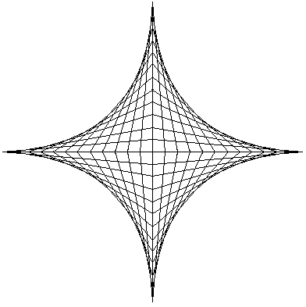
Dynamic Programming Applications
Areas
Bioinformatics
Control theory
Information theory
Operations research
Computer science:
Theory
Graphics
AI

Slide 58
Some Famous Dynamic Programming Algorithms
Integer Knapsack Problem
Unix diff for comparing two files
Bellman–Ford algorithm for finding the shortest distance in a graph
Floyd's All-Pairs shortest path algorithm
Cocke-Kasami-Younger for parsing context free grammars
en.wikipedia.org/wiki/Dynamic_programming#Algorithms_that_use_dynamic_programming

Slide 59
Summary
Divide-and-conquer method for algorithm design
Dynamic programming is a way of improving on inefficient divide-and-conquer algorithms
Dynamic programming is applicable when the sub-problems are dependent, that is, when sub-problems share sub-sub-problems
Recurrent functions can be solved efficiently
Longest increasing subsequence and Longest common subsequence problems can be solved efficiently using dynamic programming approach

Slide 60









Dynamic Programming
https://softuni.bg/trainings/1194/Algorithms-September-2015

Slide 61
License
This course (slides, examples, labs, videos, homework, etc.) is licensed under the "Creative Commons Attribution-NonCommercial-ShareAlike 4.0 International" license
Attribution: this work may contain portions from
"Fundamentals of Computer Programming with C#" book by Svetlin Nakov & Co. under CC-BY-SA license
"Data Structures and Algorithms" course by Telerik Academy under CC-BY-NC-SA license

Slide 62






Free Trainings @ Software University
Software University Foundation – softuni.org
Software University – High-Quality Education, Profession and Job for Software Developers
softuni.bg
Software University @ Facebook
facebook.com/SoftwareUniversity
Software University @ YouTube
youtube.com/SoftwareUniversity
Software University Forums – forum.softuni.bg

